Slide 1

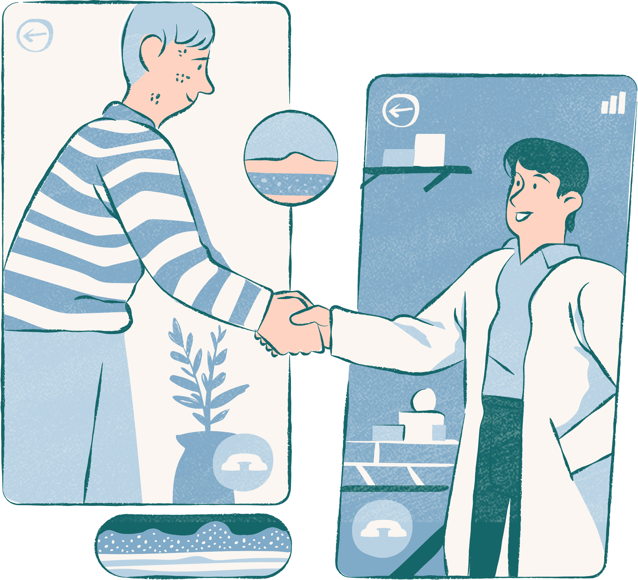
AI Medical Community
Under Supervision of
Dr. Walaa EL Sayed
2023-2024

Slide 2
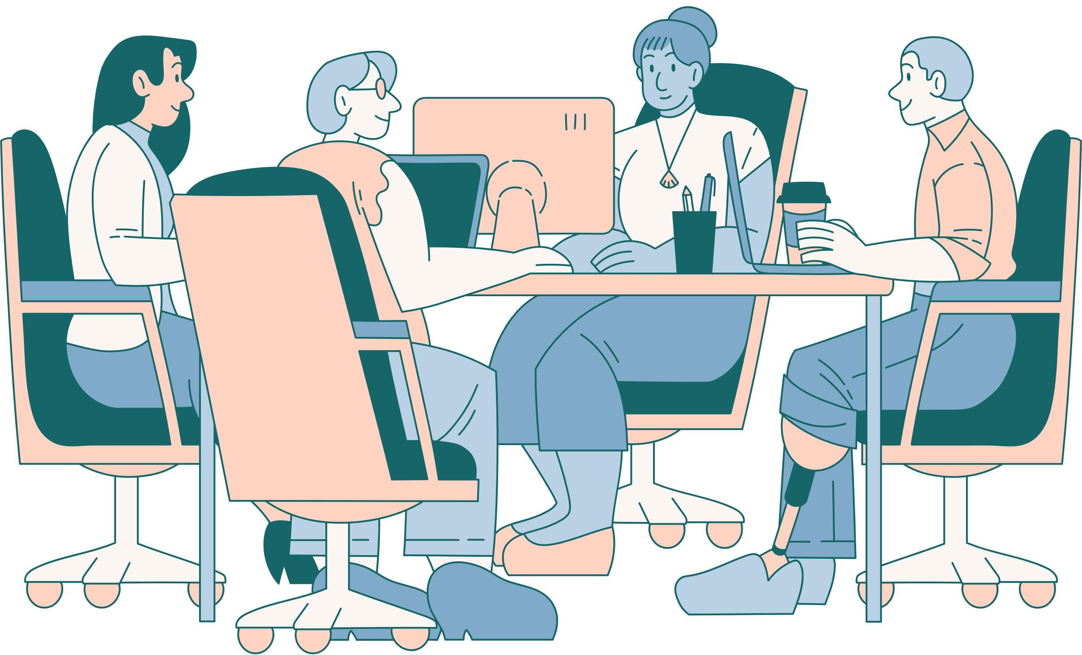
Prepared by:-
Abanoub Eshak Azmy
(20-01036)
Marina Kamel Abdeltwab
(20-00931)
Manar Mohammed Awny
(20-01117)
Abanoub Gaber Zikry
(20-00517)
Beshoy Mokhlis Agaiby
(20-01086)
Abanoub Emad Felix
(20-01523)
Andrew Samer lahzy
(20- 00437)
Teaching Assistant
Eng. Salma Montaser Abdel Hafez

Slide 3


Outlines
Introduction
ER Diagram & Schema Diagram & Use Case Diagram
Related Work
Design of Application
Demo
Dataset
System Methodology
Expert System & Flask
Refernces

Slide 4
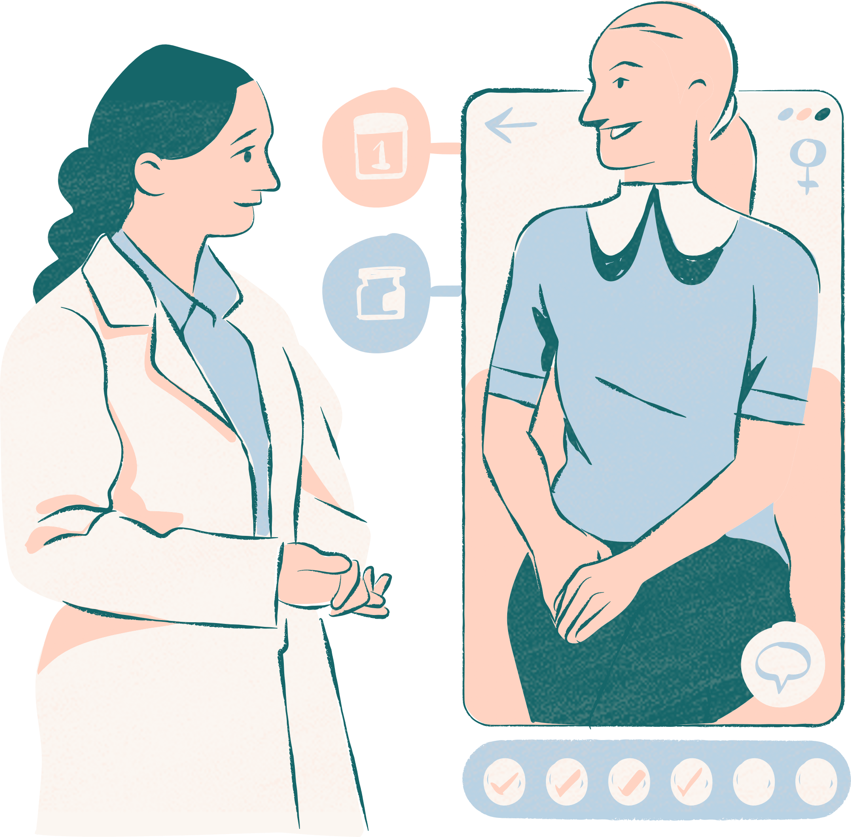
Introduction

Slide 5

Introduction :
This application is used for the initial diagnosis of the patient’s internal diseases, where the patient registers on the application with all his required information, then enters the chat page and writes the symptoms he is afflicted with, where the chat responds to him with the disease afflicting him ,and his information it is recorded in profile page, and it consists of up to 12 symptoms and 350 internal diseases, where The patient can enter 12 symptoms, then the chat responds with the disease he is afflicted with and a description of the disease for the patient to understand it.

Slide 6
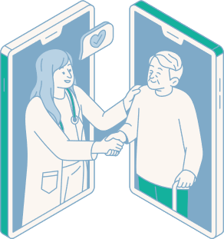
Problem Definition
The project aims to solve The problem that the patient wants to know at the same time, through the symptoms present in him, what is the initial diagnosis for these symptoms if he is traveling or at night.
So visit the nearest doctor as soon as possible

Slide 7


ER Diagram & Schema Diagram & Use Case Diagram

Slide 8

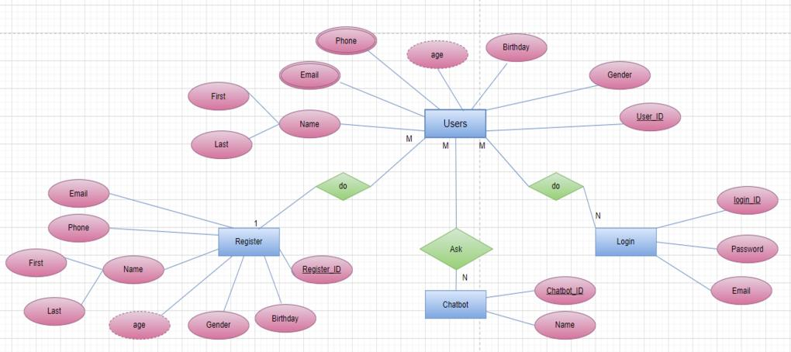
ER Diagram & Schema Diagram & Use Case Diagram : ( 1 / 3 )
ER Diagram :
Figure.1

Slide 9
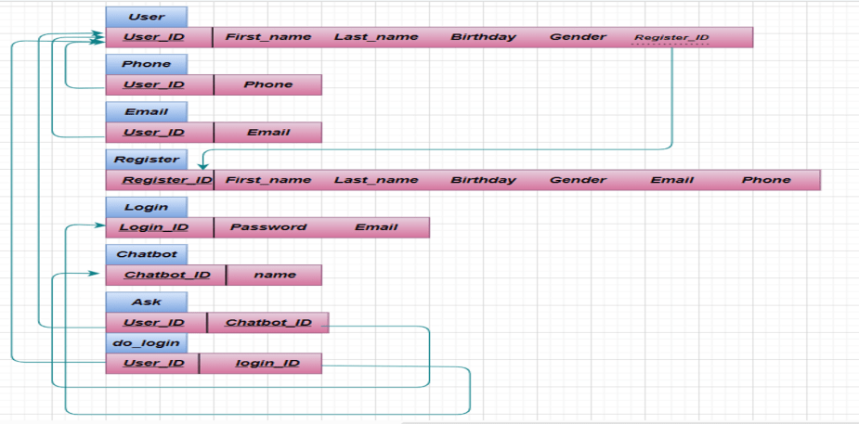
ER Diagram & Schema Diagram & Use Case Diagram : ( 2/ 3)
Schema Diagram :
Figure.2

Slide 10
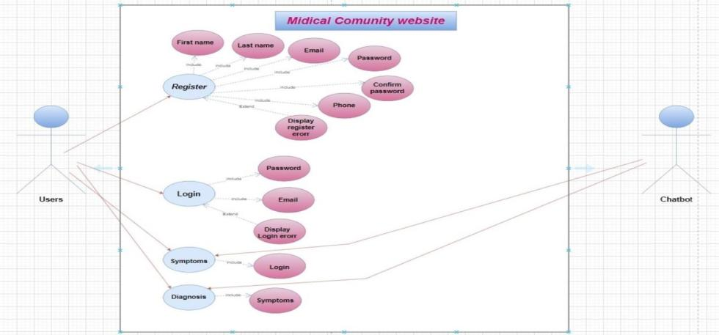
ER Diagram & Schema Diagram & Use Case Diagram : ( 3/ 3 )
Use Case Diagram :
Figure.3

Slide 11

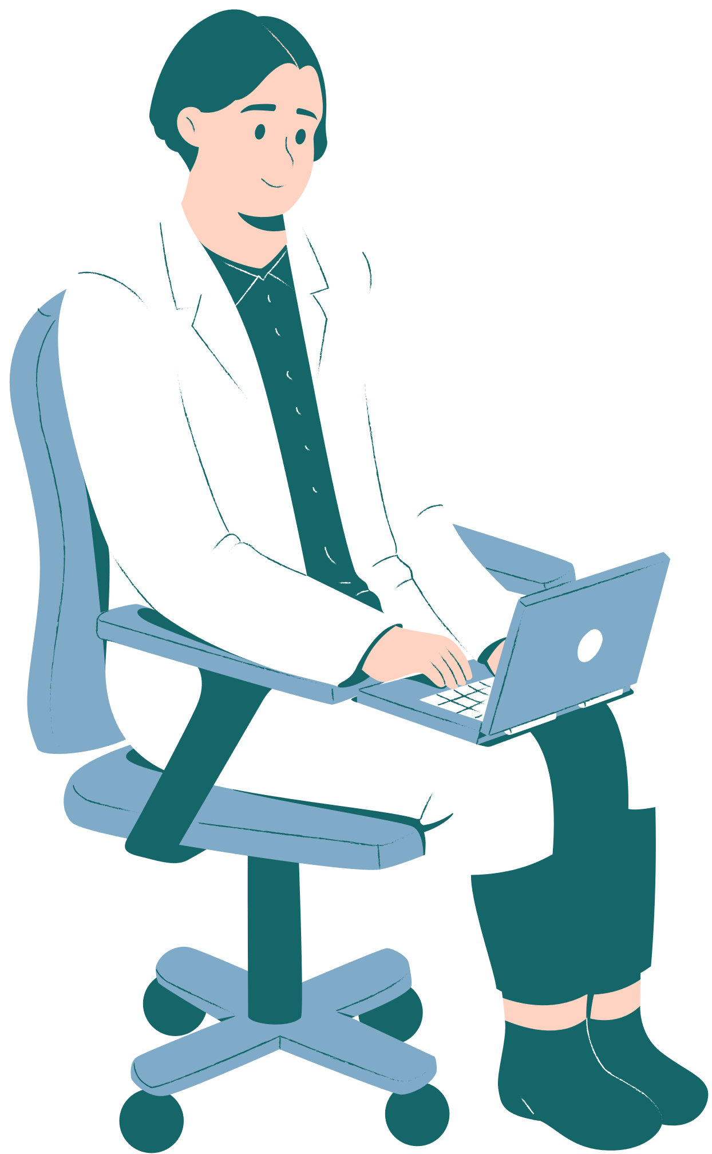
Related Work

Slide 12

Related Work : (1 / 3 )
Name article : Prevention of Gastric Cancer by Helicobacter pylori Eradication .
year : 2010
Conclusions : Whether or not H. pylori eradication therapy can suppress gastric cancer has been a serious issue in this field. Newevidence obtained from our study in Japan may be helpful for the prevention and eventual elimination of gastric cancer.

Slide 13

Related Work : (2 / 3 )
Name article : Diagnosis of Gallbladder Tumors.
year : 2011
Conclusions : Mass screening by using ultrasonography can detect gall-bladder abnormalities, among which early gallbladder carcinoma should be distinguished from other diseases. Further evaluation using endoscopic ultrasonography is useful, but recent advances in contrast-enhanced ultrasonography are expected to increase capabilities for early diagnosis.

Slide 14

Related Work : (3 / 3 )
Name article : Performance of Cardiovascular Physical Exam Skills by Internal Medicine Residents.
year : 2024
Conclusions : Internal medicine interns had variable skills in performing and interpreting the cardiovascular physical exam. Improving cardiovascular exam skills would likely lead to increased identification of relevant cardiovascular findings, inform clinical decision making and improve overall patient care.

Slide 15

Design of Application

Slide 16
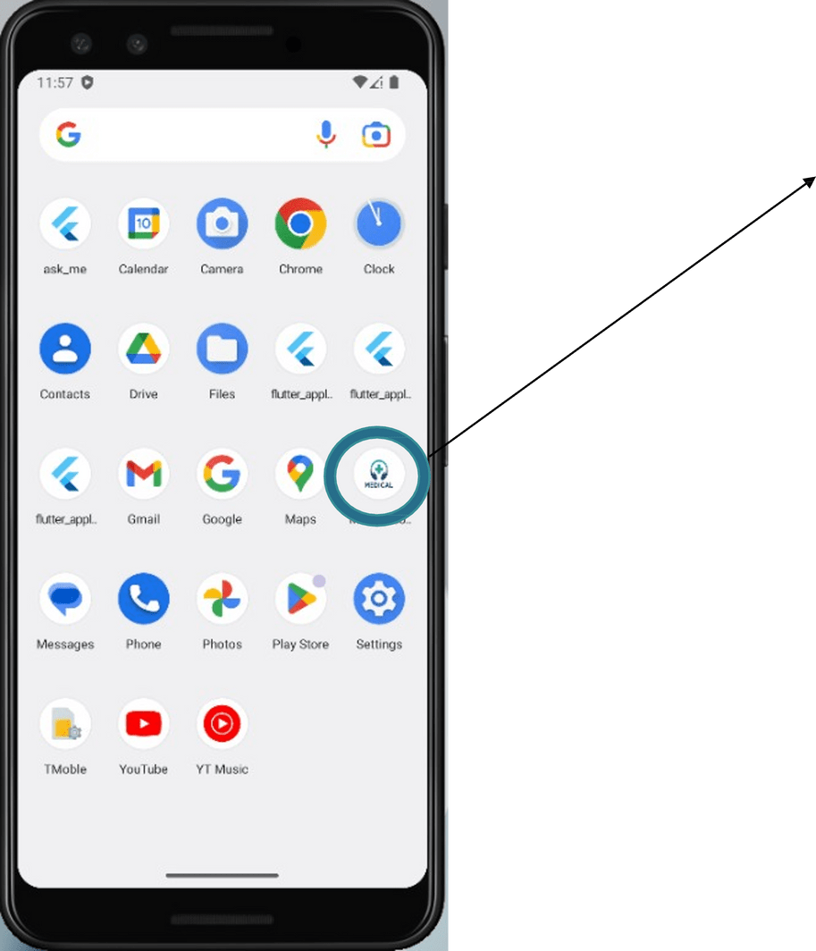
Design of Application :
01.
Framework
Flutter
This is the Medical community application
02.
Language Dart
03.
Tool Figma
Figure.4

Slide 17
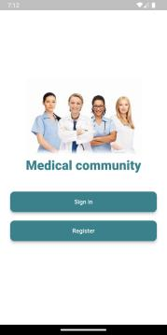
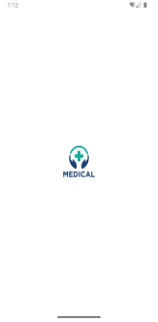
Design of Application :
Welcome pages :
This page contains buttons Sign in and Register , Where the user clicks on sign in if he has previously logged in, or clicks on register if he is logging in for the first time.
Figure.5
Figure.6

Slide 18
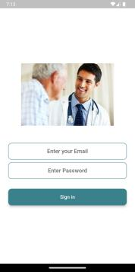
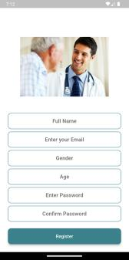
Design of Application :
Sign Up & Sign In :
The user enters all the data on Sign Up page, then the user registers on the application, and the application takes him to a Sign In page where he enters his email and password.
Figure.7
Figure.8

Slide 19
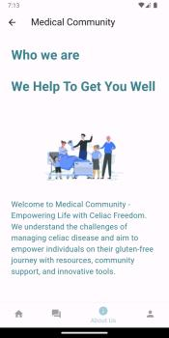
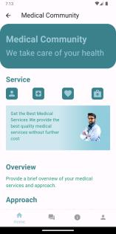
Design of Application :
Home & About Us:
Home : This page contains on service for patient and overview us and through it , You can navigate between pages.
About Us : This page contains on information about us, And our services and excellence.
Figure.9
Figure.10

Slide 20
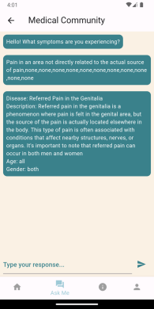
Design of Application :
Ask me Chatbot :
This page is a chatbot through which the patient can express the symptoms he feels. He enters the symptoms he feels at the bottom of the screen, then presses enter, then the chat responds to him with the disease he is afflicted with and a description of the disease, age, and gender, which is a rudimentary diagnosis for the patient.
Figure.11

Slide 21
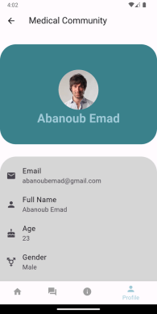
Design of Application :
Profile :
This page stores the information of the user who registered on the login page, which contains the email, full name, gender, and age.
Figure.12

Slide 22

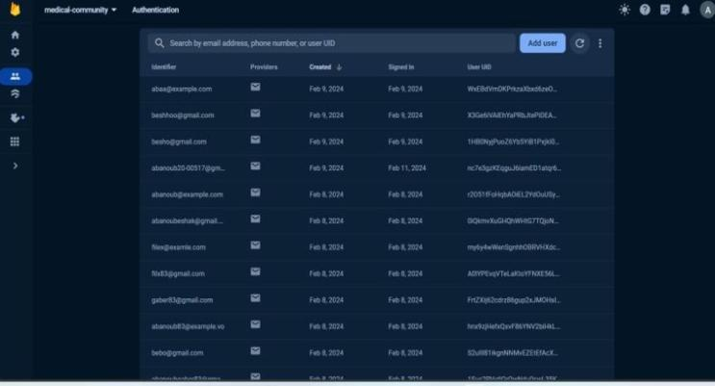
Language We Used Back-End
Figure.13

Slide 23
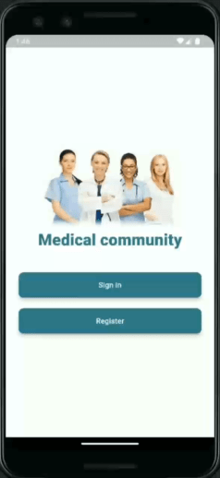
Demo

Slide 24

DATASET

Slide 25

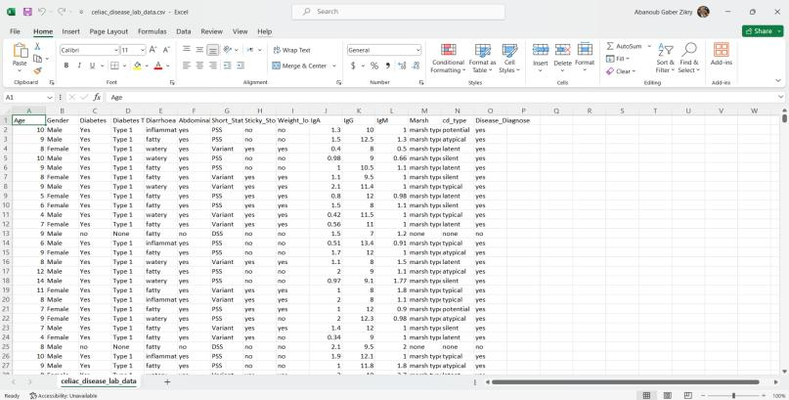
OLD DATASET
DATASET
Figure.14

Slide 26
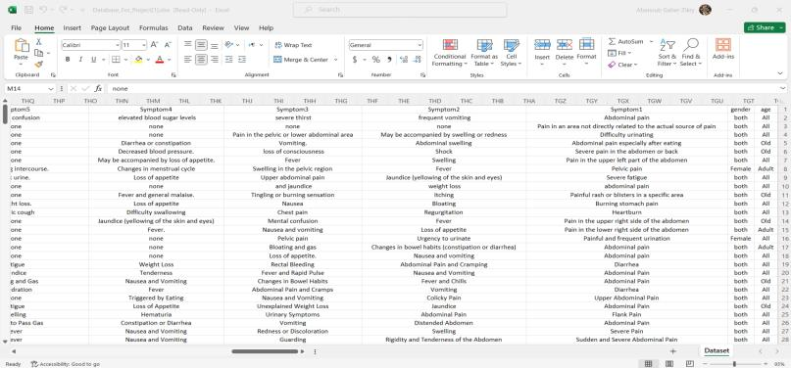
NEW DATASET
DATASET
Figure.15

Slide 27
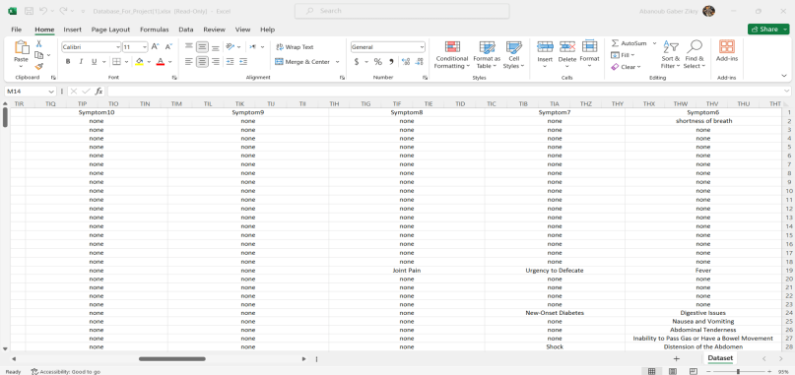
NEW DATASET
DATASET
Figure.16

Slide 28
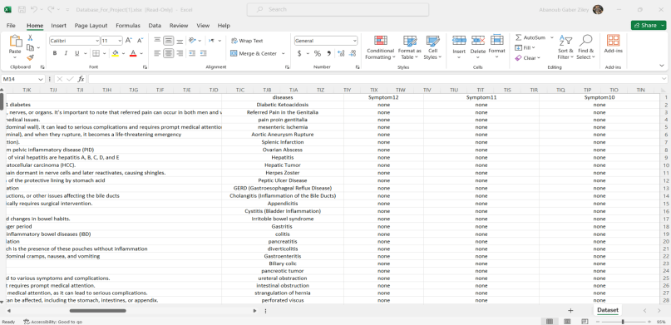
NEW DATASET
DATASET
Figure.17

Slide 29

System Methodology

Slide 30
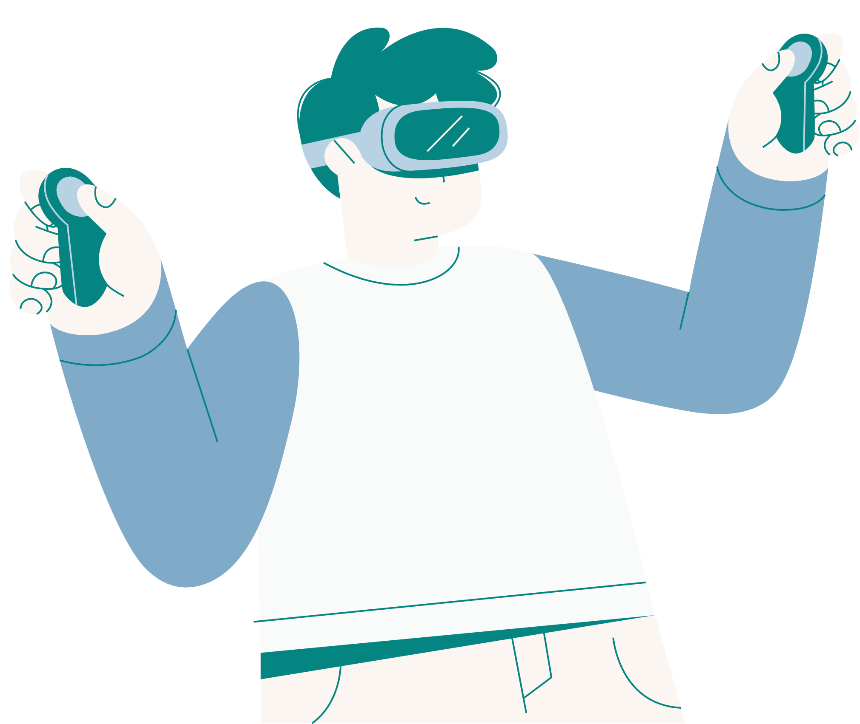
System Methodology (1)
Machine Learning
Editor
Google Colab &
Visual Studio Code
Language
Python
Model
Randome forest

Slide 31

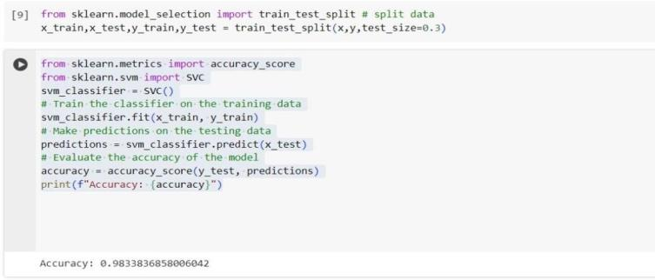
System Methodology (2)
Before
Machine learning on Old dataset
SVM
98%
Figure.18

Slide 32
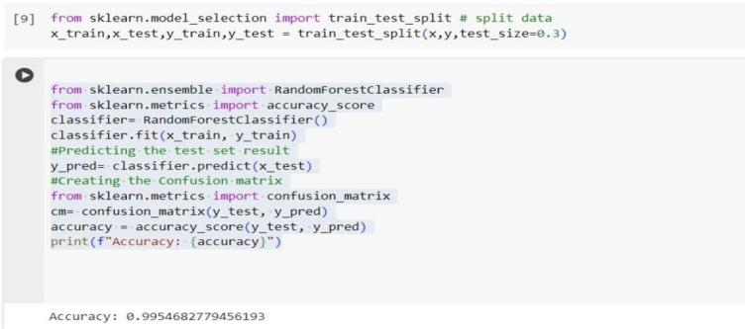
System Methodology (3)
Before
Machine learning on Old dataset
Random Forest
99%
Figure.19

Slide 33
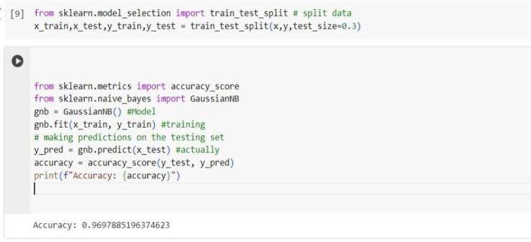
System Methodology (3)
Before
Machine learning on Old dataset
Naive Base
96%
Figure.20

Slide 34
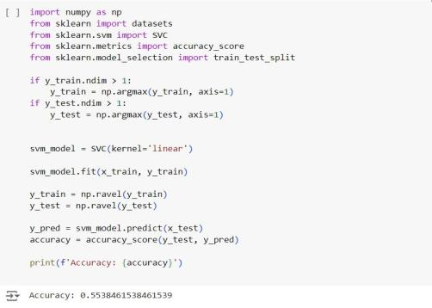

System Methodology (4)
After
Machine learning on New dataset
55%
SVM
Figure.21

Slide 35
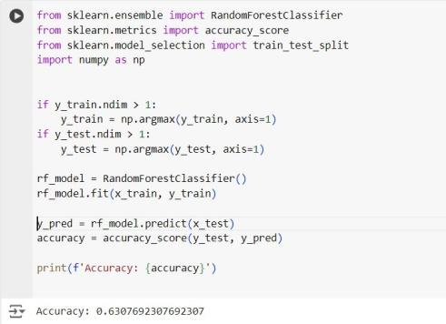
System Methodology (5)
After
Machine learning on New dataset
63%
Random Forest
Figure.22

Slide 36
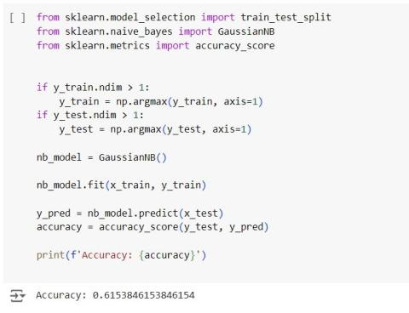
System Methodology (5)
After
Machine learning on New dataset
61%
Naive Base
Figure.23

Slide 37
Machine learning on New dataset
The problem
The solution
is the accuracy bad in 3 algorithms
we took refuge to expert system

Slide 38



Expert System & Flask

Slide 39


EXPERT SYSTEM
An expert system is a computer program designed to emulate and mimic the decision-making abilities of a human expert in a specific domain. It's a type of artificial intelligence (AI) system that utilizes knowledge stored in a knowledge base to reason and make decisions in a manner similar to a human expert.
Expert systems have been used in various fields such as medicine, finance, engineering, and manufacturing, among others. They are valuable tools for decision support, problem-solving, and knowledge management, especially in situations where access to human experts may be limited or costly.
Expert systems typically consist of two main components:
1. Knowledge Base: This component stores information, facts, rules, and heuristics about a particular domain. It's essentially the repository of knowledge that the system relies on to make decisions.
2. Inference Engine: The inference engine is the reasoning component of the expert system. It uses the knowledge stored in the knowledge base to draw conclusions, make inferences, and provide solutions or recommendations based on the input provided by the user.

Slide 40


EXPERT SYSTEM
Knowledge Base
1-Loading the Knowledge Base: The Knowledge Base class holds all the rules for diagnosing diseases. Each rule consists of symptoms and corresponding disease information.
2-Populating the Knowledge Base: This part reads the CSV file containing the disease rules and populates the Knowledge Base with these rules. Each row in the CSV file represents a rule with symptoms and corresponding disease details.
1-Known Symptoms: A set of symptoms provided by the user.
2-Inferred Diseases: A set of diseases inferred based on the known symptoms.
3-Disease Info: A dictionary to store information about the inferred diseases.
The algorithm iterates through the rules in the knowledge base and checks if the symptoms in each rule are a subset of the known symptoms. If a rule's symptoms match, the corresponding disease is inferred, and its information is added to disease_info. The process continues until no more rules can be applied.
Inference Engine
1-Inference Engine Initialization: The Inference Engine class uses the Knowledge Base to infer diseases based on given symptoms. The constructor takes an instance of Knowledge Base.
2-Forward Chaining Algorithm:
This method implements the forward chaining algorithm:

Slide 41

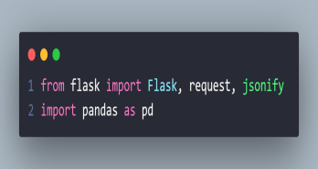
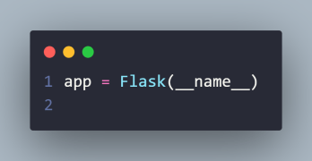
Expert System & Flask :
1. Importing Libraries:
flask: A micro web framework for Python.
pandas: A data manipulation and analysis library, used here to read and process the CSV file.
2. Initializing the Flask App:
This initializes a Flask web application.
Figure.24
Figure.25

Slide 42
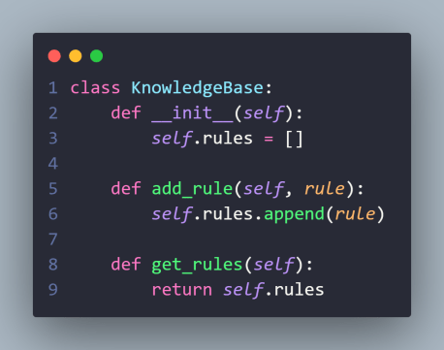
Expert System & Flask :
Defining the Knowledge Base Class:
Knowledge Base class is used to store rules each rule represents a disease and its associated symptoms.
Figure.26

Slide 43
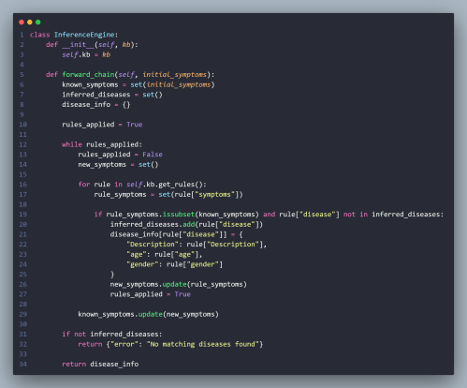
Expert System & Flask :
Defining the Inference Engine Class:
Inference Engine class implements the forward chaining inference method.
It starts with the initial symptoms and tries to infer possible diseases by applying rules in the knowledge base.
It keeps applying rules until no new rules can be applied .
Figure.27

Slide 44
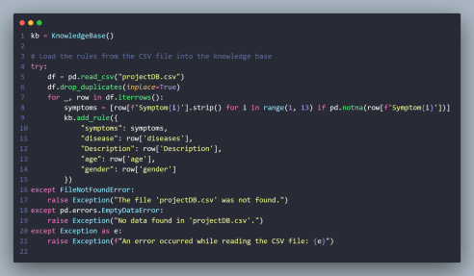
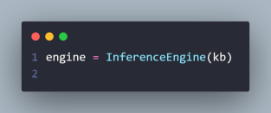
Expert System & Flask :
1- Initializing the Knowledge Base and Loading Rules from CSV:
Reads the CSV file (projectDB.csv) and adds each row as a rule in the knowledge base.
Each rule consists of a list of symptoms, a disease, and additional information like description, age, and gender.
2- Creating an Inference Engine Instance:
Creates an instance of Inference Engine with the knowledge base.
Figure.28
Figure.29

Slide 45
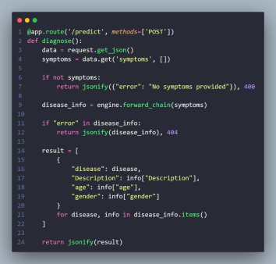
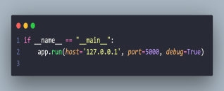
Expert System & Flask :
1- Defining the /predict Endpoint:
Defines a POST endpoint /predict which accepts JSON data containing symptoms.
It checks if symptoms are provided; if not, returns an error.
Uses the inference engine to diagnose diseases based on the symptoms.
Returns the inferred diseases and their details as a JSON response.
Figure.30
2- Running the Flask App:
Runs the Flask app on localhost (127.0.0.1) at port 5000 with debug mode enabled.
Figure.31

Slide 46
Refernces
https://youtube.com/playlist?list=PLw6Y5u47CYq47oDw63bMqkq06fjuoK_GJ&si=HJ6h3dPWM1X7XuSt
https://www.kaggle.com/datasets/jackwin07/celiac-disease-coeliac-disease?resource=download
https://flutter.dev/
https://youtu.be/tIlUSf0ojV4?si=fuJc9Lxkhor4Tz88
https://youtu.be/-a14O3Y2t0w?si=KhhUOsGvmK7z2Cwc
https://www.appicon.co/
https://youtu.be/99dnktVT-t4?si=tto7fbZmkXzlSu6C
https://youtu.be/iZPICyh05wU?si=qK1_jJg-myGsyFlwhttps://youtu.be/iZPICyh05wU?si=qK1_jJg-myGsyFlwhttps://youtu.be/iZPICyh05wU?si=qK1_jJg-myGsyFlw
https://scholar.google.com/
https://youtu.be/QYKnX2VFkH8?si=qr5mg_2jusuWYZuC
https://youtu.be/V9TYFe7hJy0?si=EqsgV2Li9wzCqCxd
https://youtu.be/xQ2qiM0Zpr8?si=82ZXhGBy6aIHoWFz
https://youtu.be/2qyH5LDxLdc?si=SgS0EH819Y6nftyU
https://youtube.com/playlist?list=PL5zwAWCFLn1si9EScxEkfQkDhx1i4YW4s&si=3iWh5Ua1pduYmUer

Slide 47



THANK YOU

